Slide 1
POLITO WORKSHOP

Slide 2
INTRODUCTION
FEATURES
The sensors acquire measures and send to amazon’s cloud
LINKAGE & ACCESS
Wifi module
Database on SD card
MANAGEMENT
Web site

Slide 3
COMPONENTS
SD card
DHT 11 module (humidity/temperature sensor)
Moisture module
WiFi module
Light module
Broker
Web site to check measurements

Slide 4
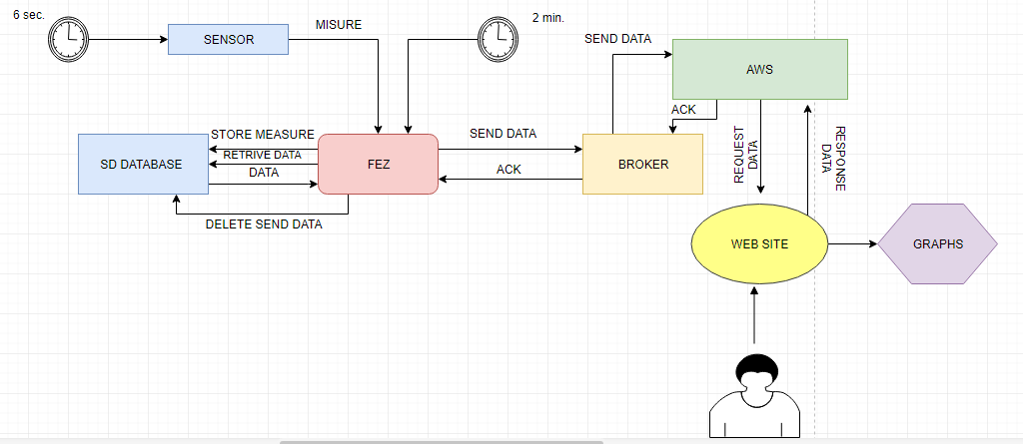
WORK FLOW

Slide 5
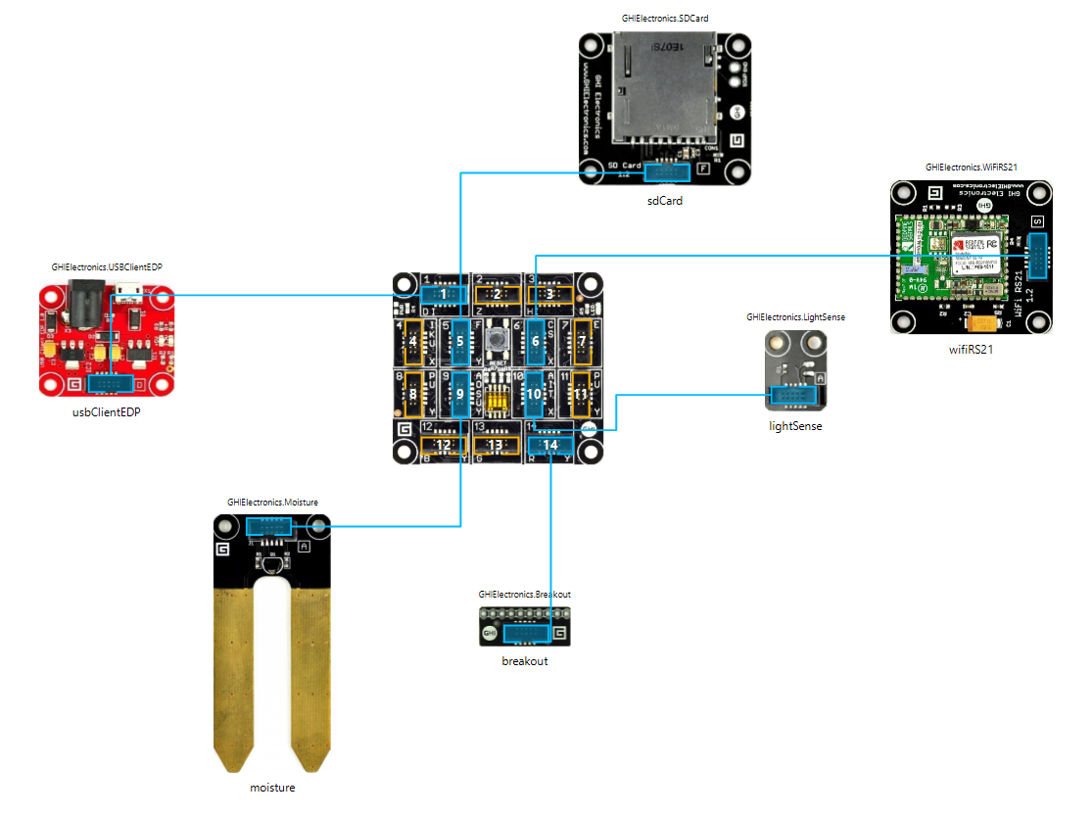
HARDWARE SCHEMATICS

Slide 6
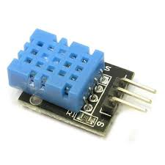
DHT 11 MODULE
Module to measure temperature and humidity of air
Socket number: 14
Connect with breakout
PROBLEMS :
Reading measure problem with FEZ interaction
Tristate
SOLUTION:
Class ad hoc (DRIVER)
Bridge on breakout

Slide 7
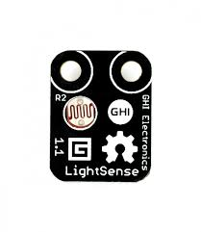
LIGHT MODULE
GHI
Socket number: 10
Take measurement of enviroment light

Slide 8
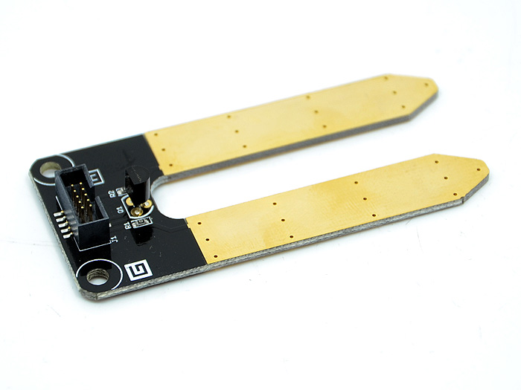
MOISTURE MODULE
Socket number: 9
Take measurements of ground

Slide 9
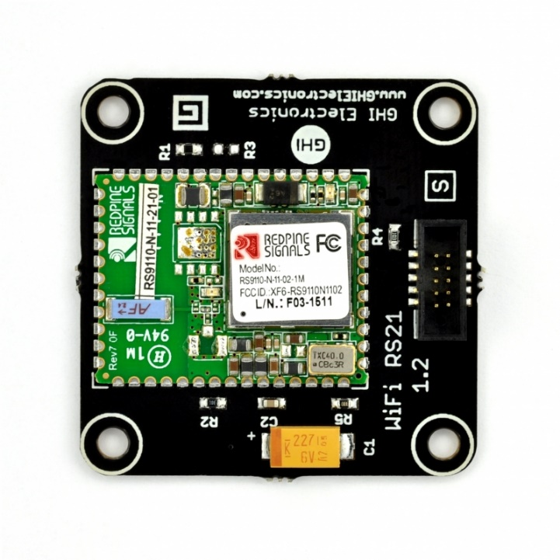
WIFI MODULE
GHI Electronics Wi-Fi RS21
Socket number: 6
Allow to connect to internet
MQTT connection
Recive ACK from broker

Slide 10
STORAGE FEZ
Database which contains the measurements
Sensore name, sensore ID, timestamp, value, number of packet

Slide 11
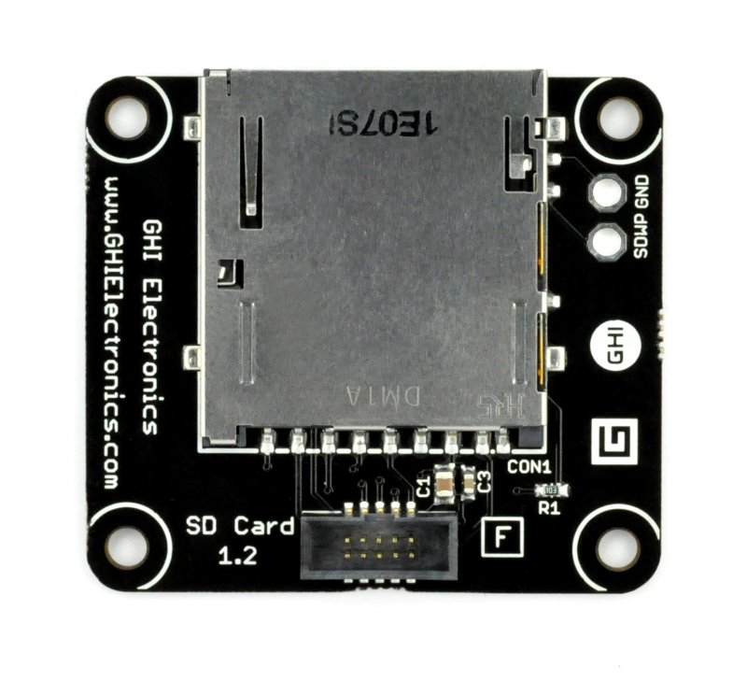
SD CARD
Creation of database (JSONs) with measurements
Socket number: 5
Backup if FEZ off
Configuration JSON

Slide 12
BROKER
PC that recive JSONs data
Take ack from cloud
Send ack to FEZ
Graphic user interface
Send own IP for connection

Slide 13
WEB SITE
Used languages are javascript and HTML
FEZ map
List of sensors about selected FEZ
Take measurements and configuration from AWS (S3 bucket)

Slide 14
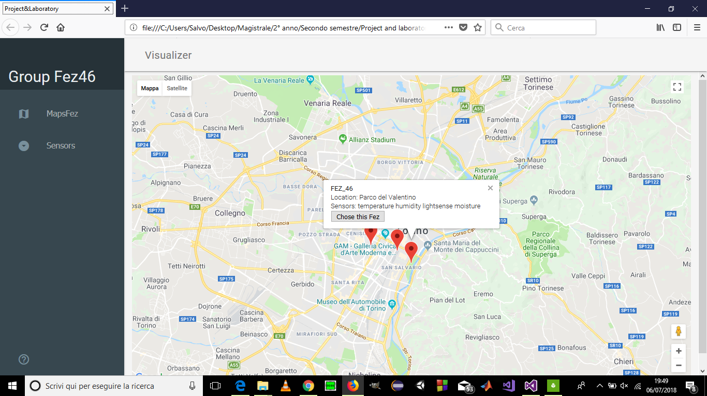
WEB SITE
MAP

Slide 15
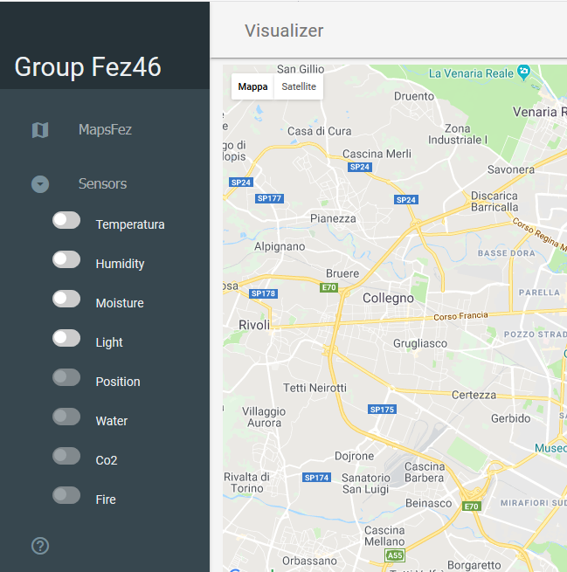
WEB SITE
SENSORS

Slide 16
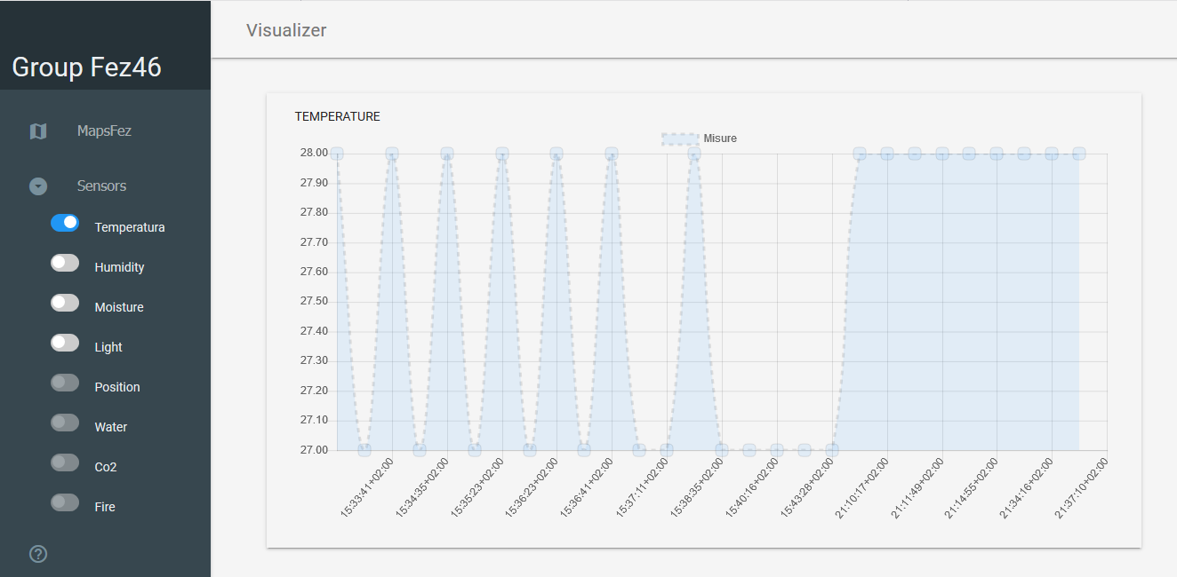
WEB SITE
GRAPHS

